Slide 1
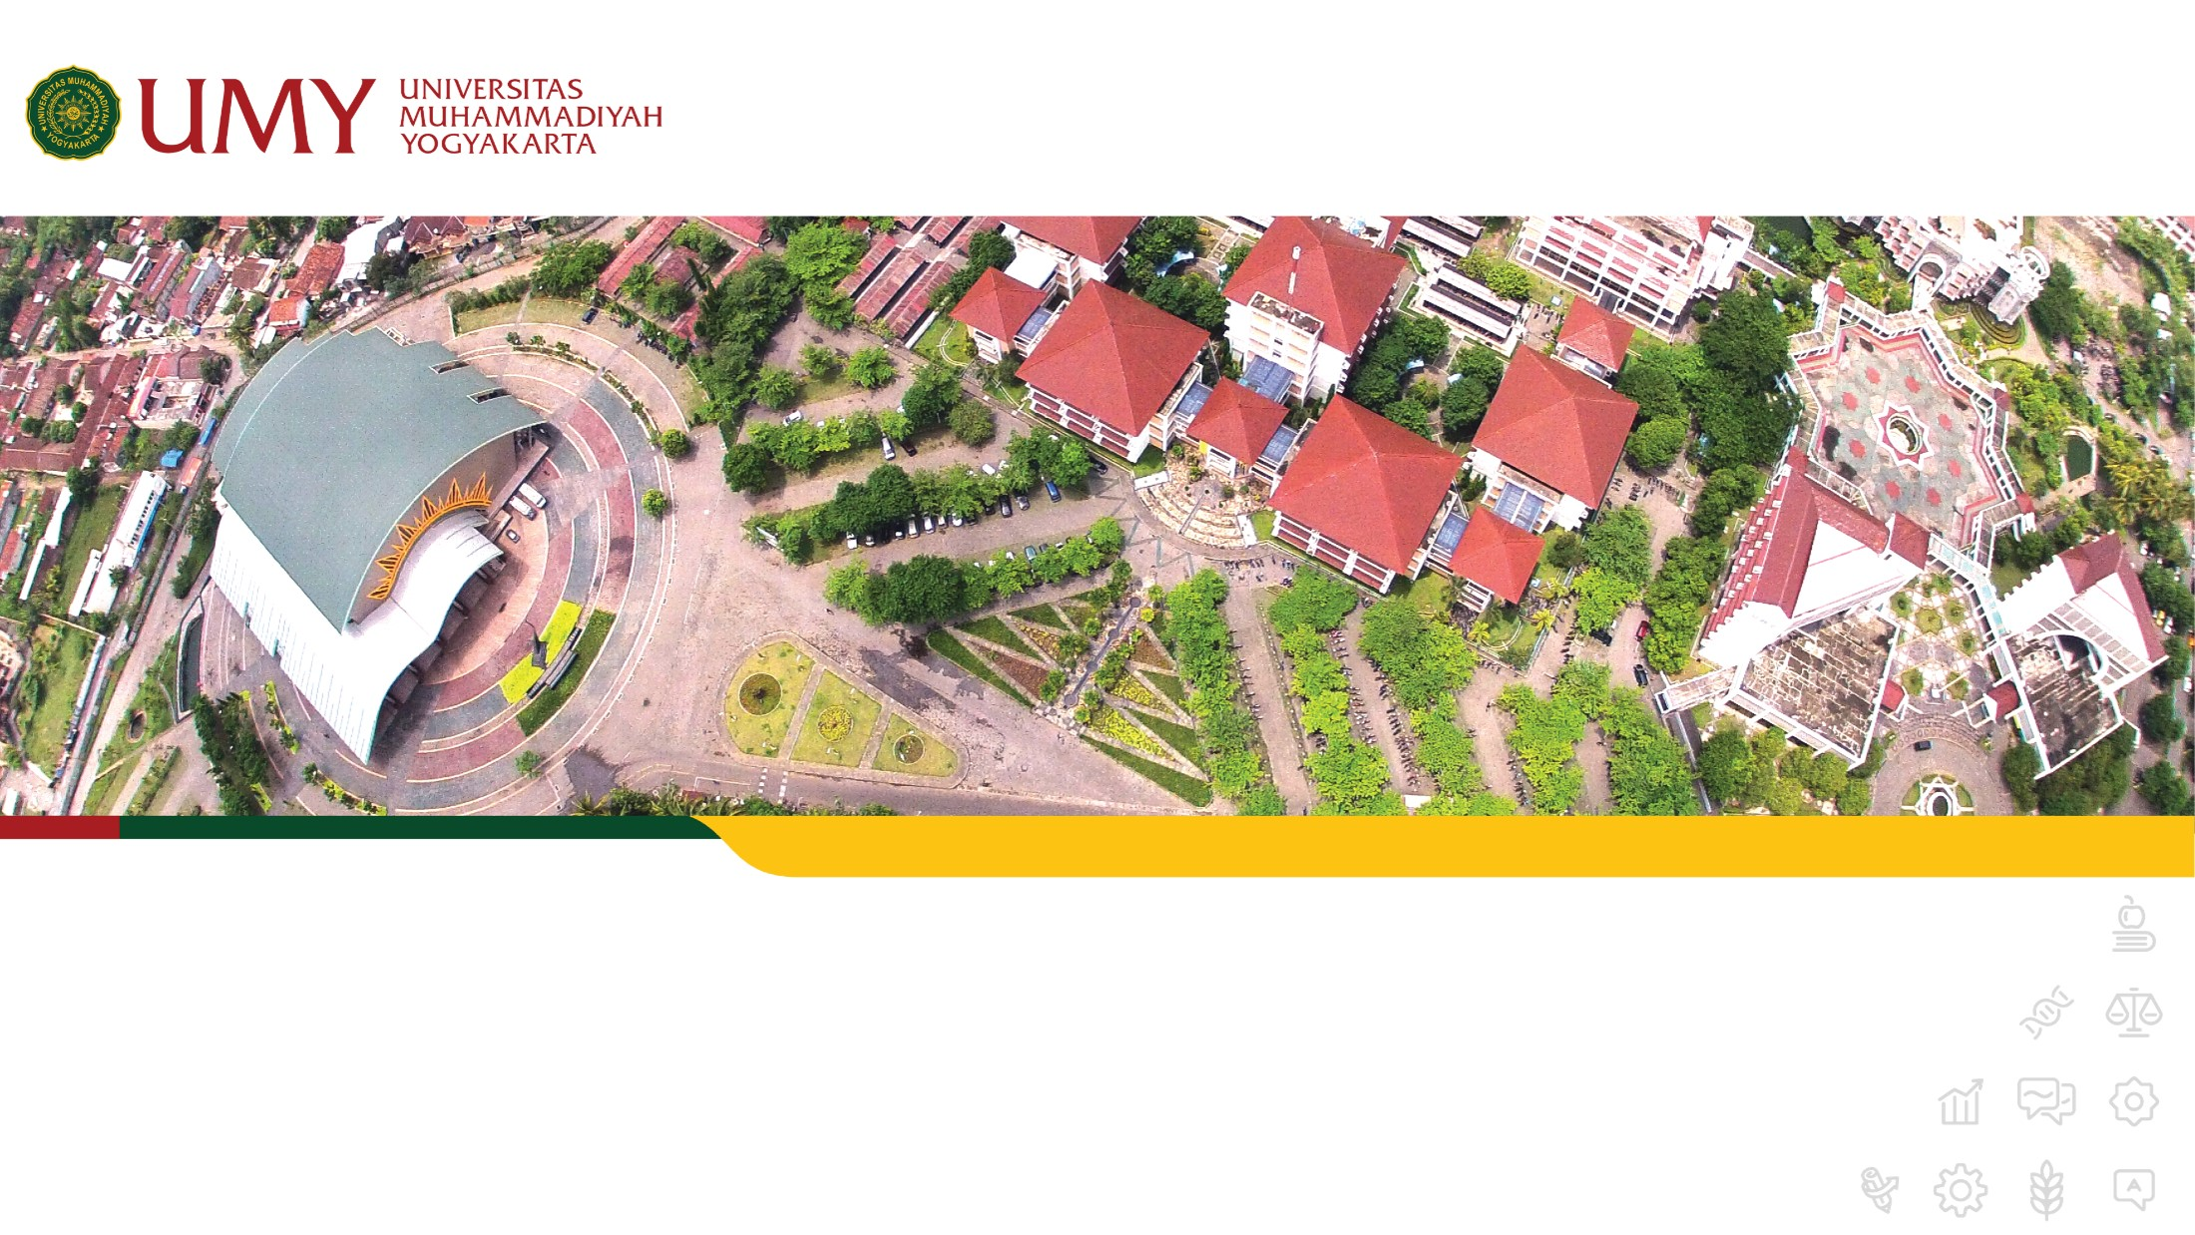

The future starts today, not tomorrow.
www.umy.ac.id
Computer
Reza Giga Isnanda, S.T., M.Sc.
Rabu, 12 April 2023

Slide 2
Today
Computer:
Input
Output
Computer Capability

Slide 3
Today Learning Outcome
Mahasiswa memahami aspek komputer dan hubungannya dengan interaksi sistem

Slide 4
Computer

Slide 5

Human is the main character in HCI

Slide 6
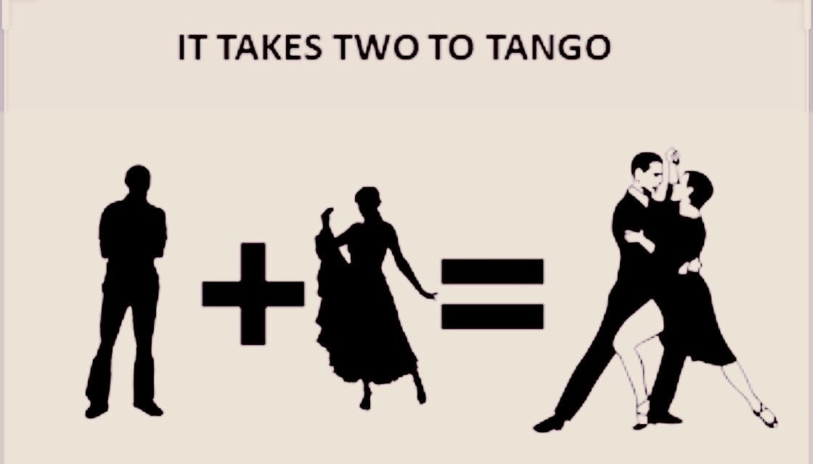

Slide 7


Slide 8
It is not enough to only learn about them

Slide 9
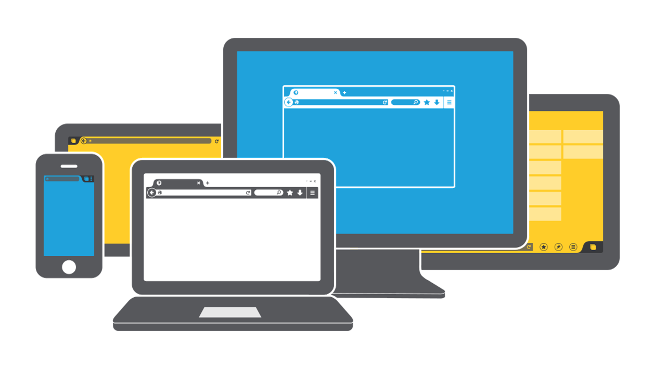
We must learn about them

Slide 10
Computer
Input
Output
Computer Capability

Slide 11
But wait….

Slide 12
When I said computer…
Notes:
Computer disepakati sebagai barang/benda/sistem yang mampu mengirim, menampilkan, menyimpan, mengubah, atau memproses informasi yang bisa dipahami manusia

Slide 13
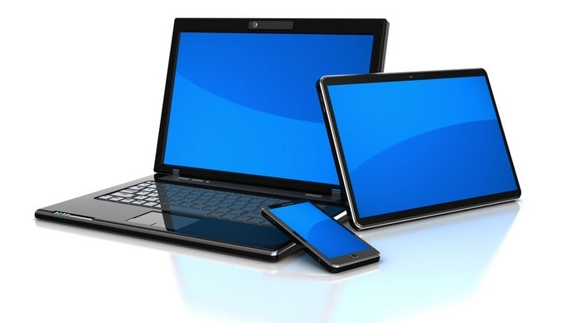
You mean this?

Slide 14


Slide 15
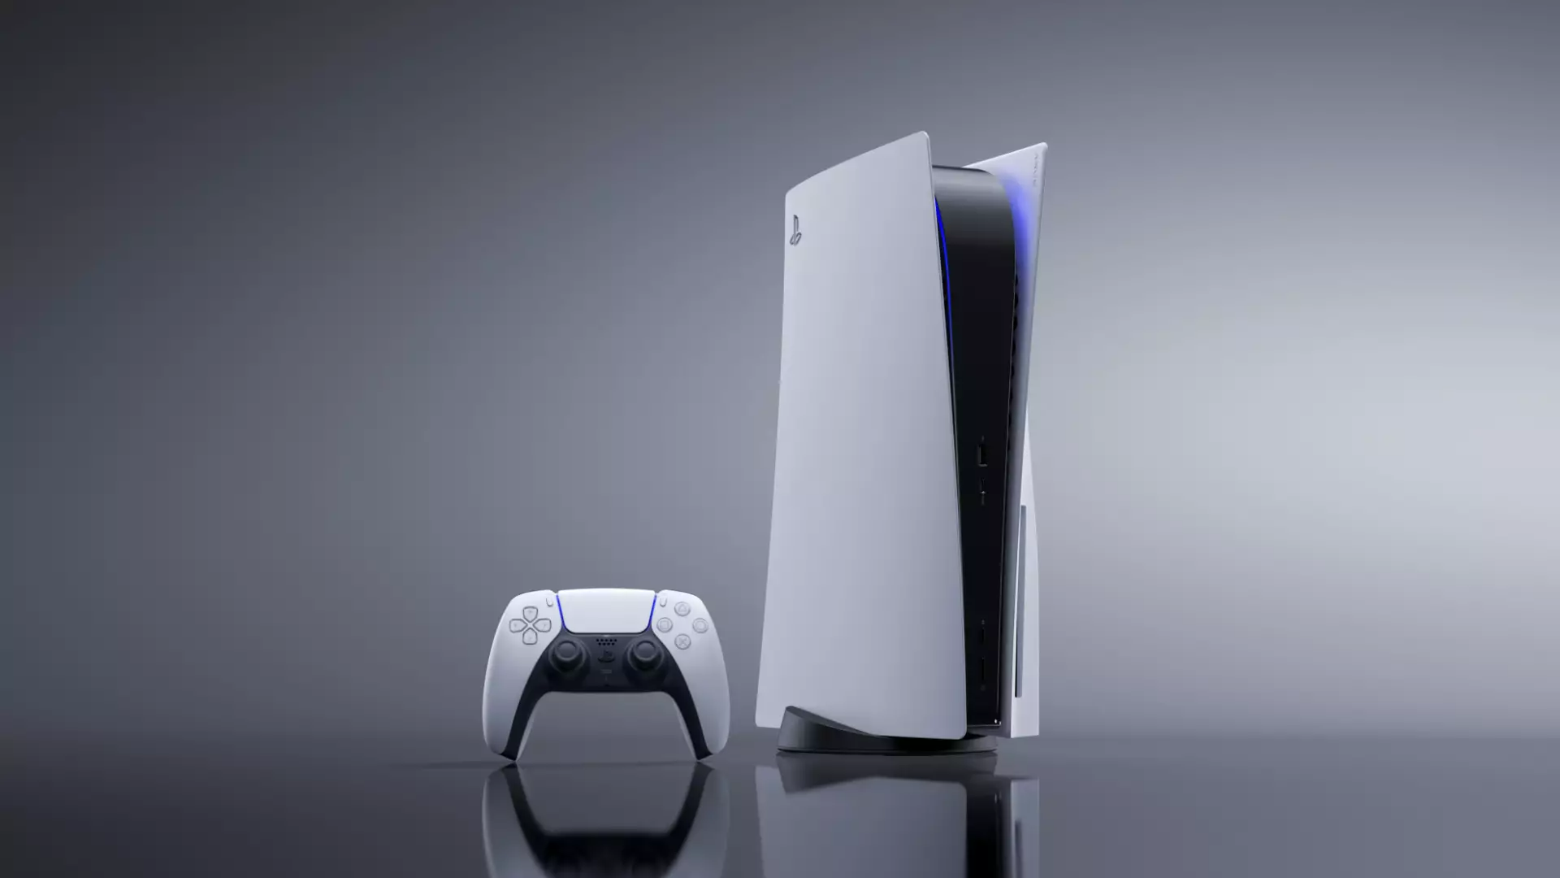
This is also a computer

Slide 16
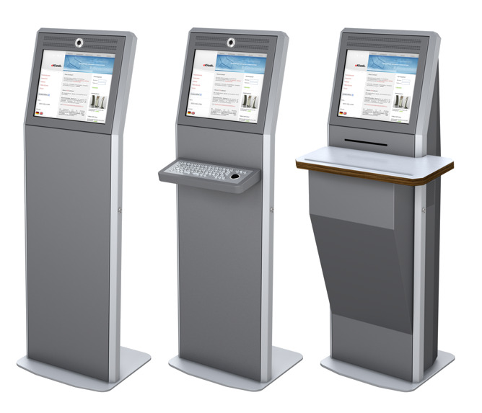
This is also a computer

Slide 17

This is also a computer

Slide 18
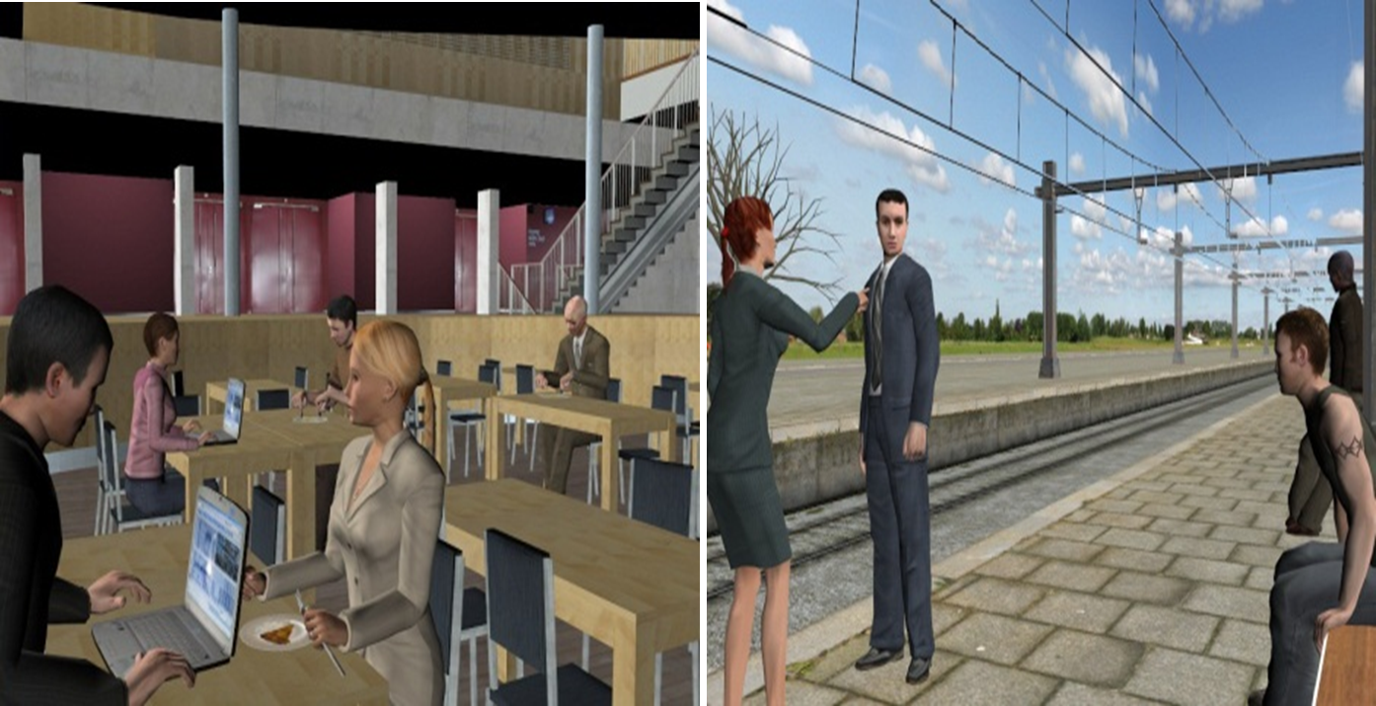
This is also a computer

Slide 19
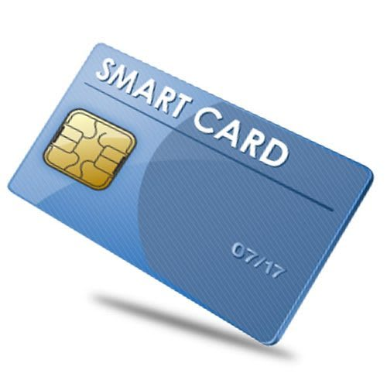
This is also a computer

Slide 20
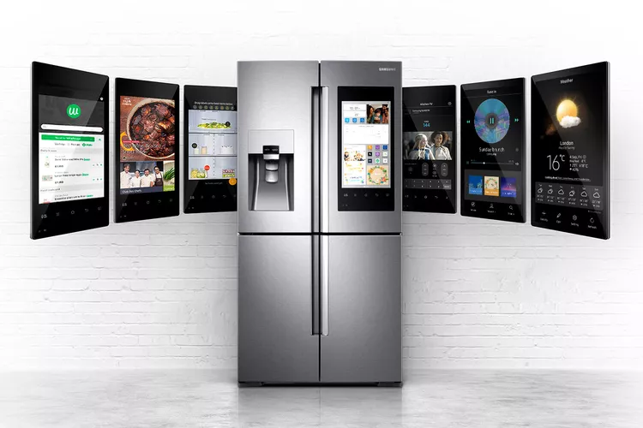
This is also a computer

Slide 21
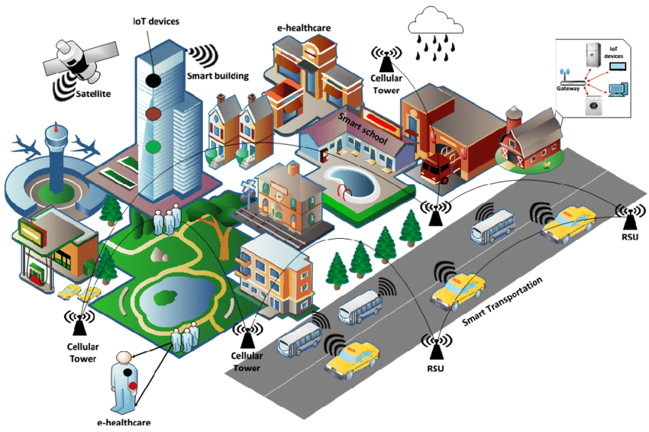
This is also a computer

Slide 22
Input

Slide 23
Input
Keyboard
Keypad
Mouse
Touchpad
Touch screen/stylus
Joystick
Physical Control
Scanner
Smart card
Mic
Camera
Graphic Tablet
Sensors
Hand Gesture
Eye tracker
Brain Computer Interface

Slide 24
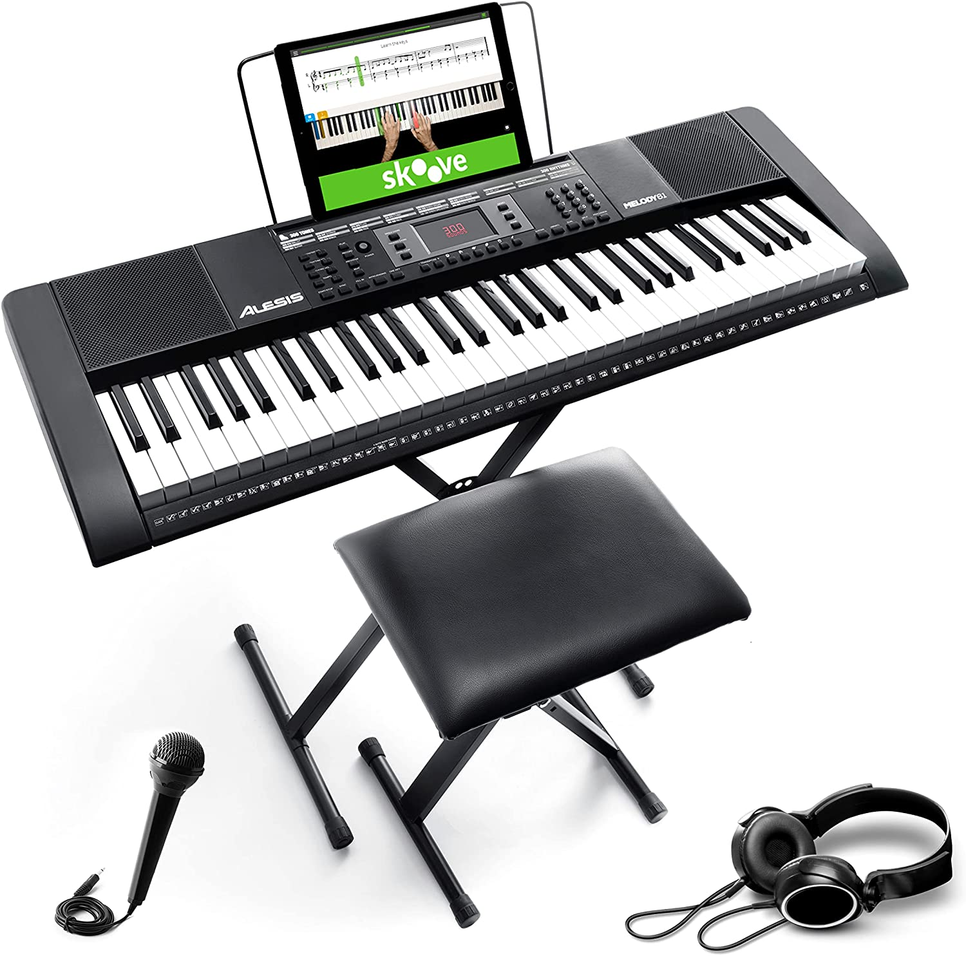
Input - Keyboard

Slide 25
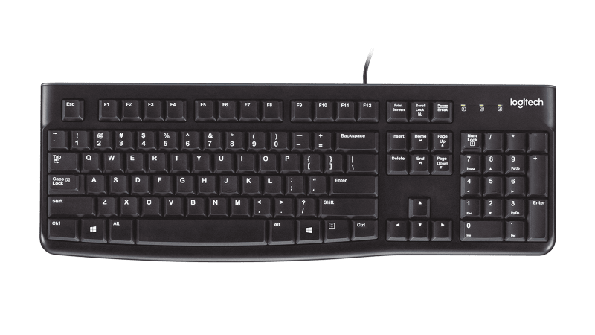
Input - Keyboard

Slide 26
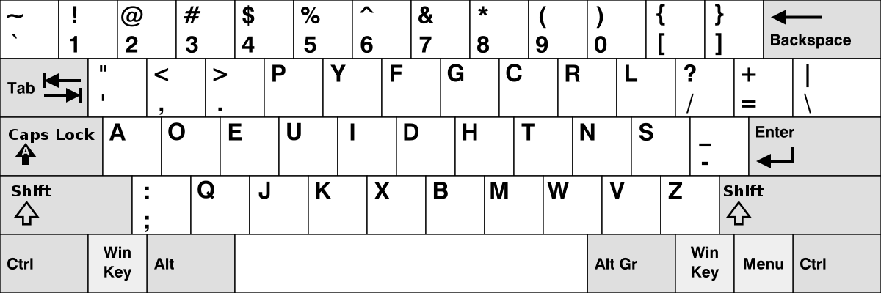
Input - Keyboard
Notes:
Dvorak

Slide 27
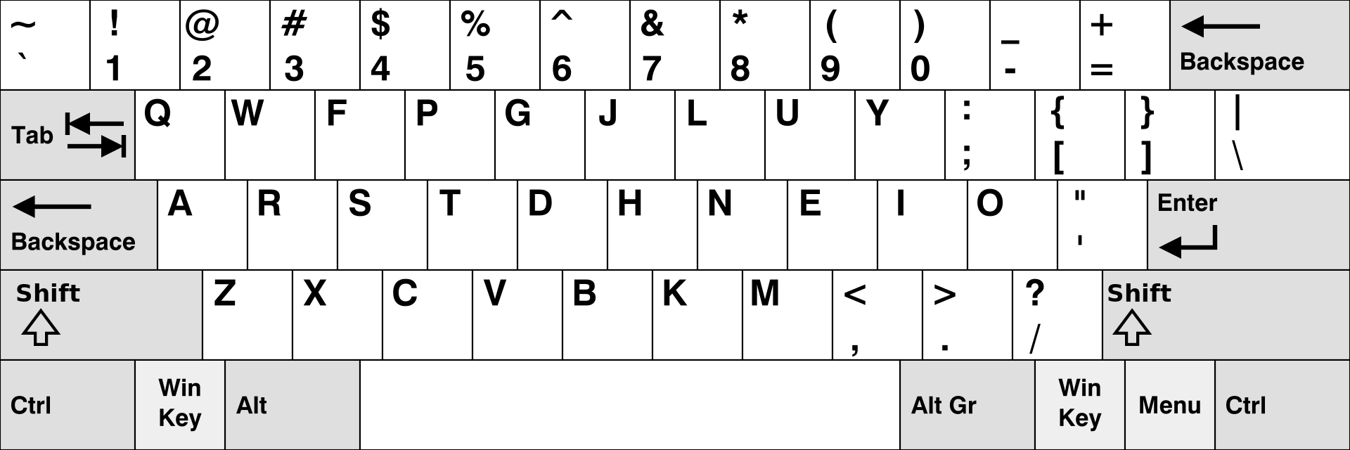
Input - Keyboard
Notes:
Colemak

Slide 28
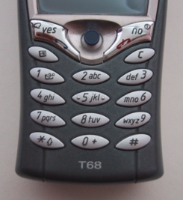
Input - Keyboard

Slide 29
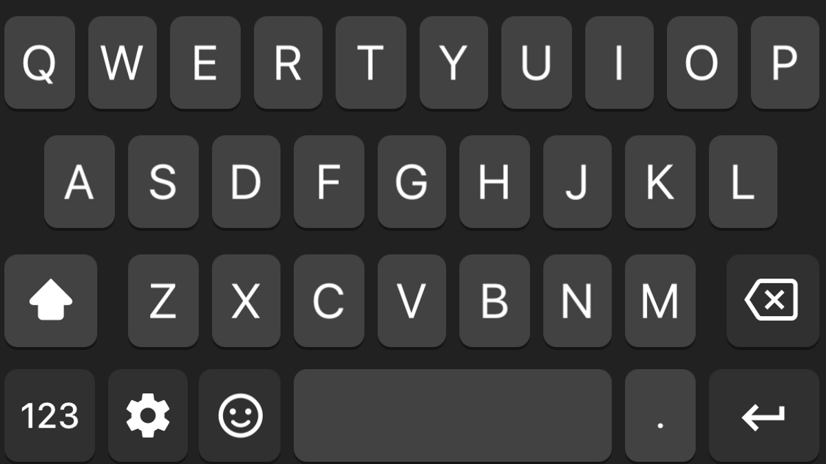
Input - Keyboard

Slide 30
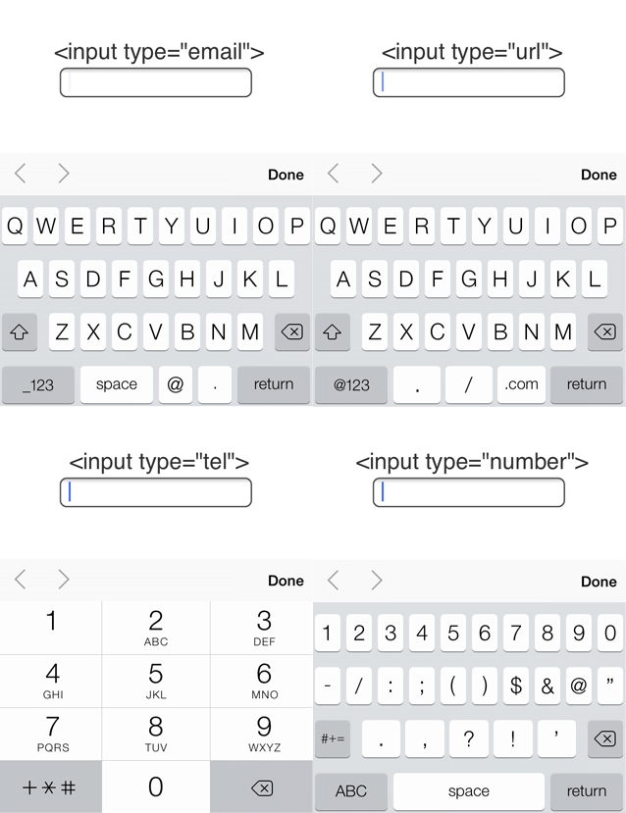

Slide 31
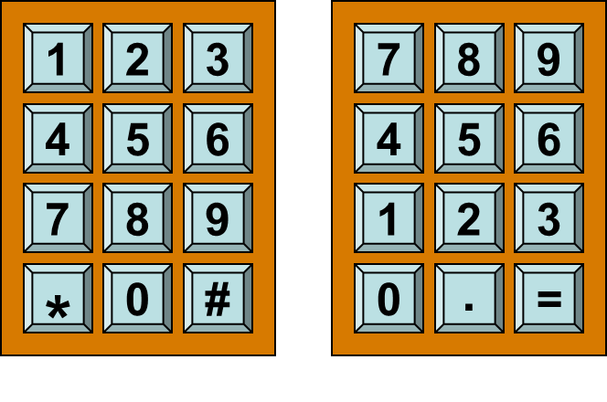
Input - Keypad

Slide 32
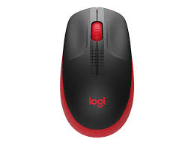
Input – Mouse

Slide 33
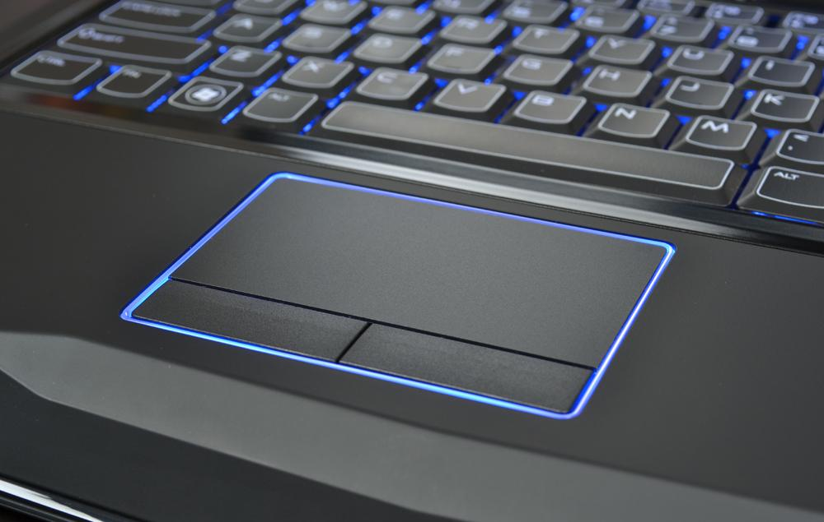
Input - Touchpad

Slide 34
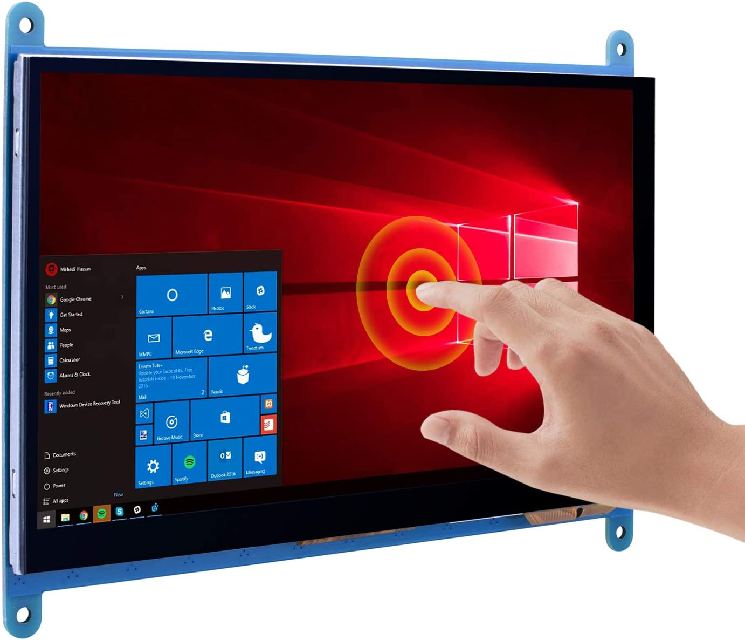
Input – Touch Screen/Stylus

Slide 35
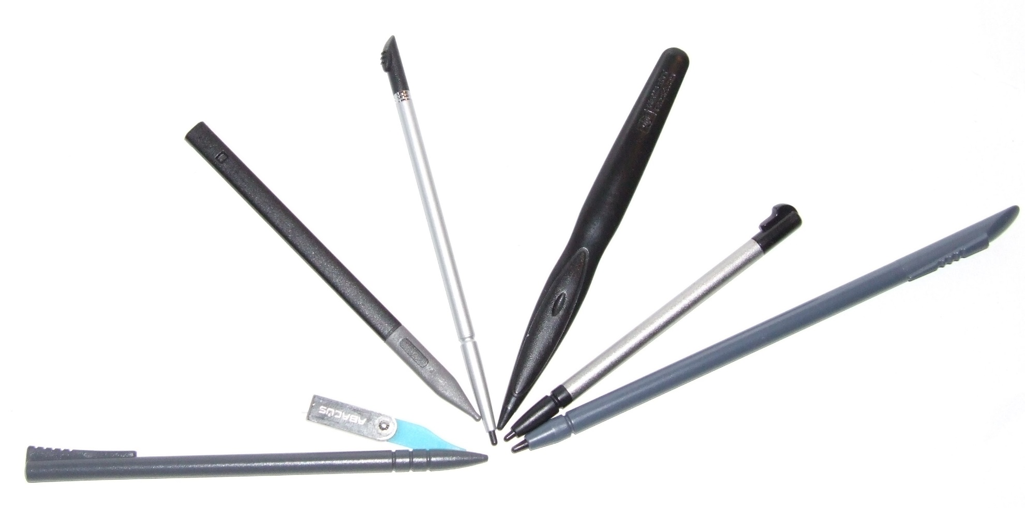
Input – Touch Screen/Stylus

Slide 36
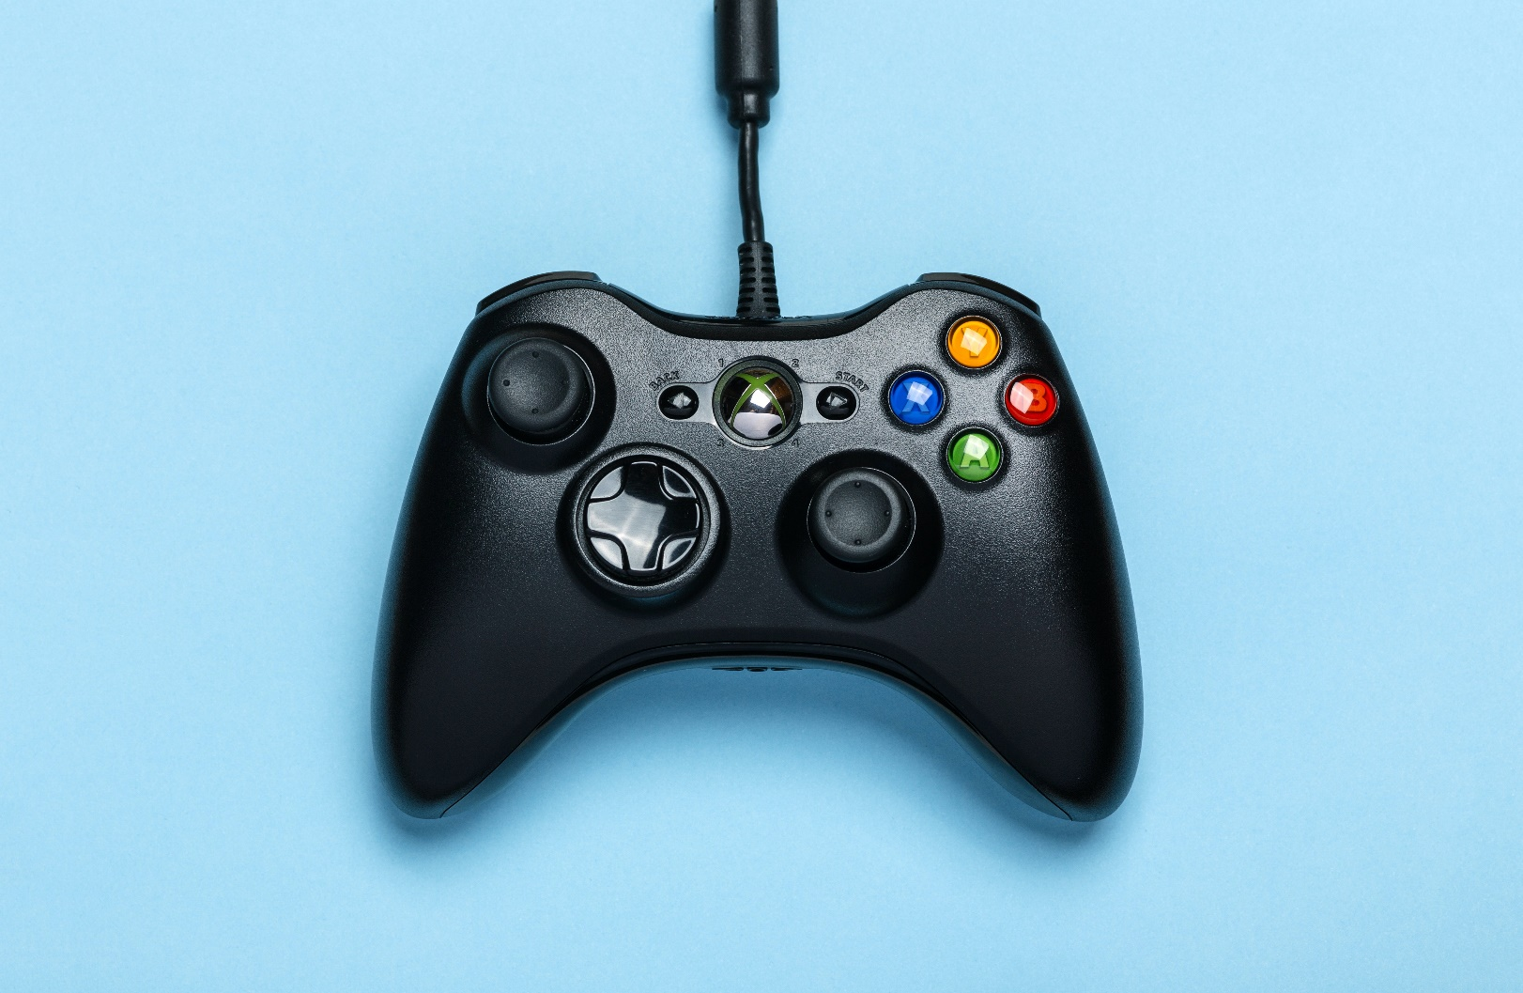
Input - Joystick

Slide 37
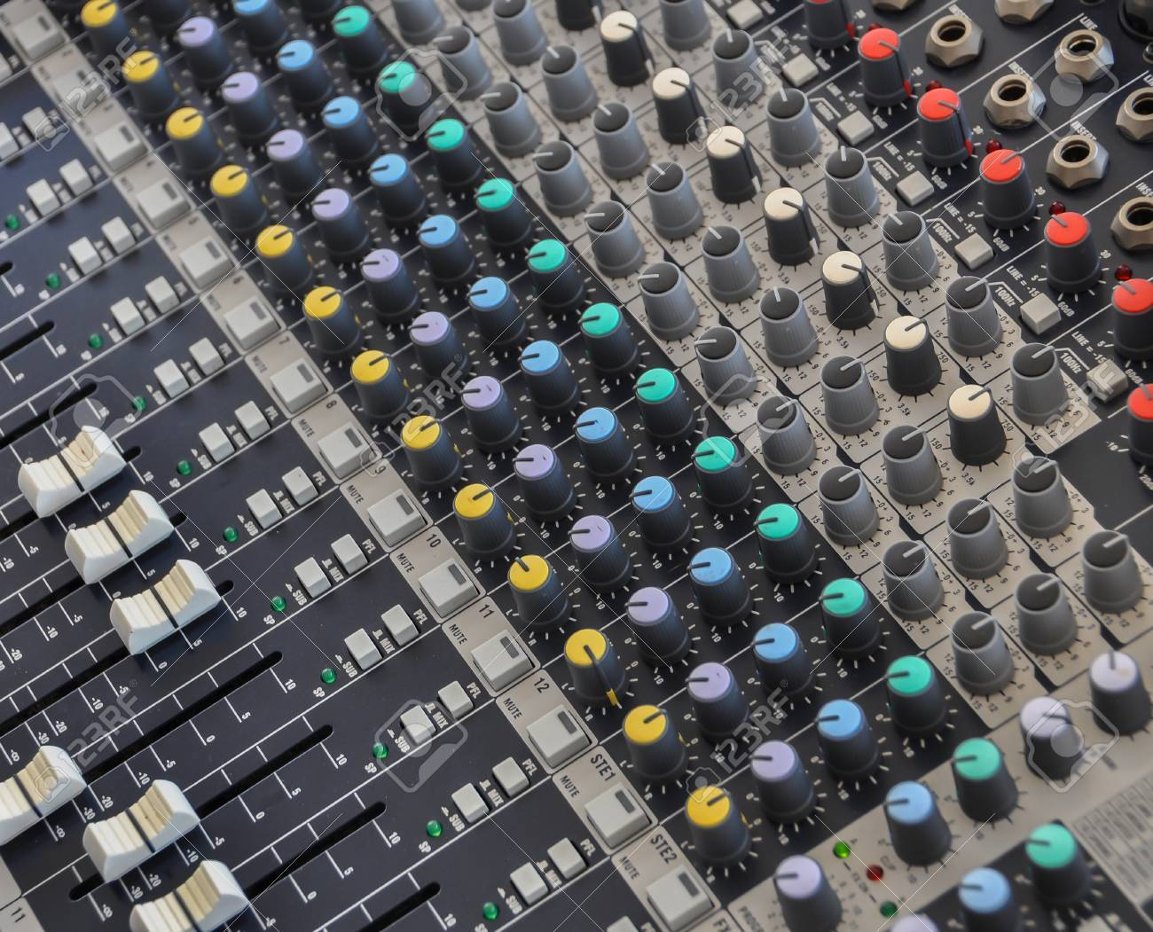
Input – Physical Control

Slide 38
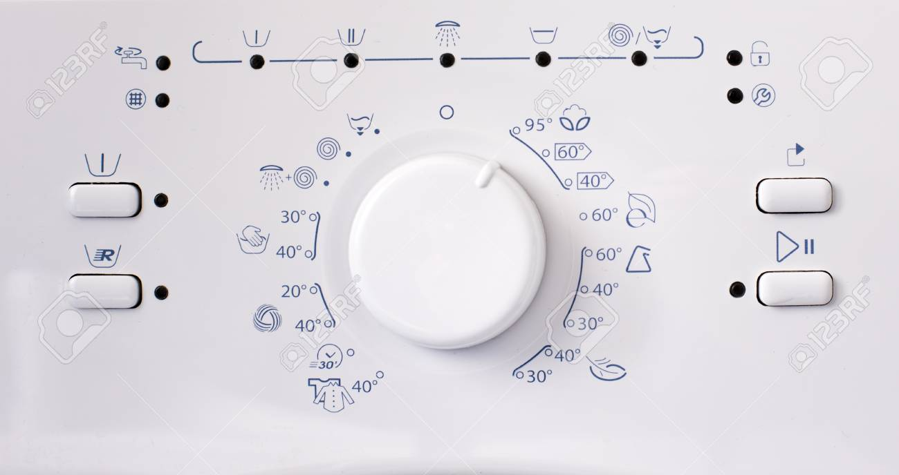
Input – Physical Control

Slide 39
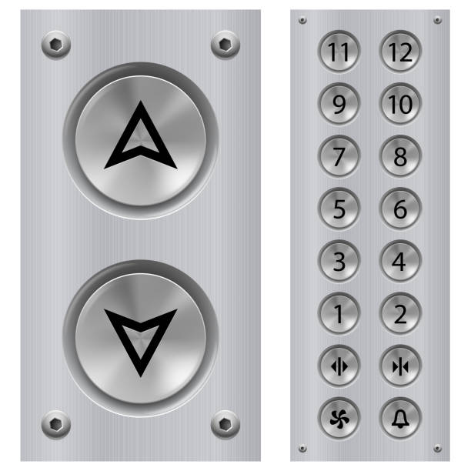
Input – Physical Control

Slide 40
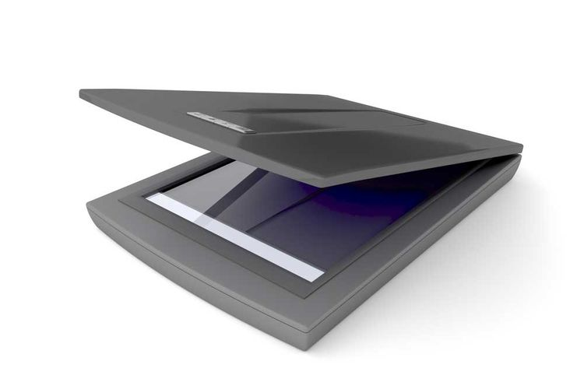
Input - Scanner

Slide 41
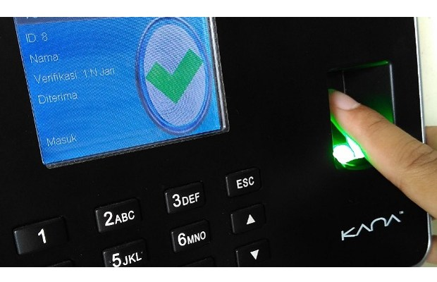
Input - Scanner

Slide 42
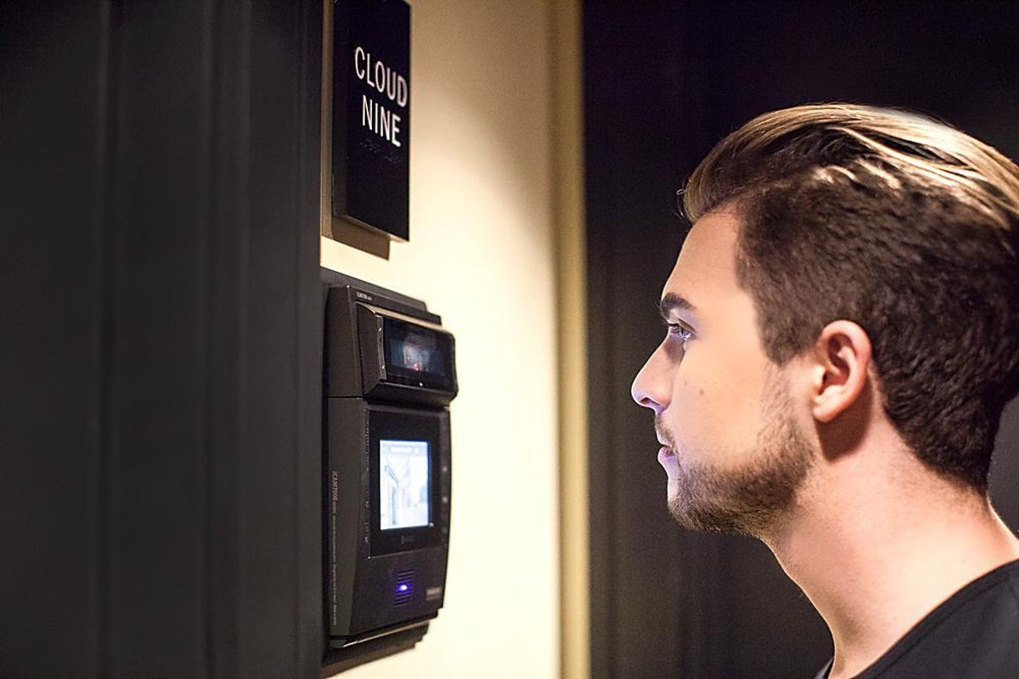
Input – Scanner

Slide 43
Input – Smart Card

Slide 44
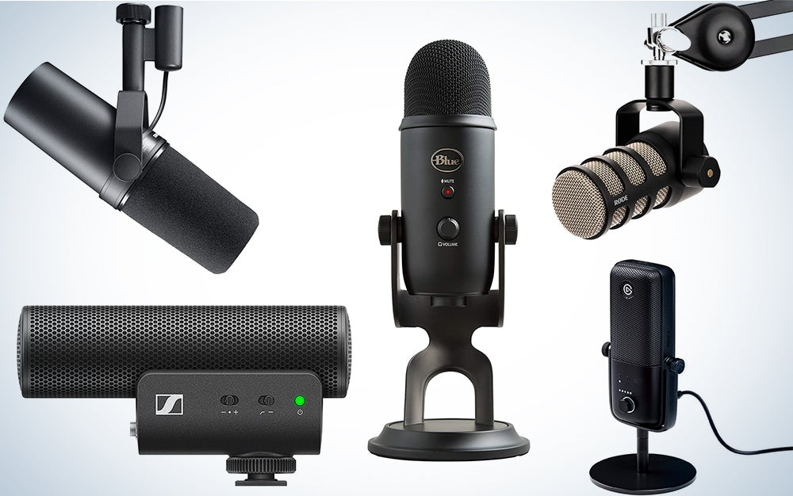
Input – Mic

Slide 45
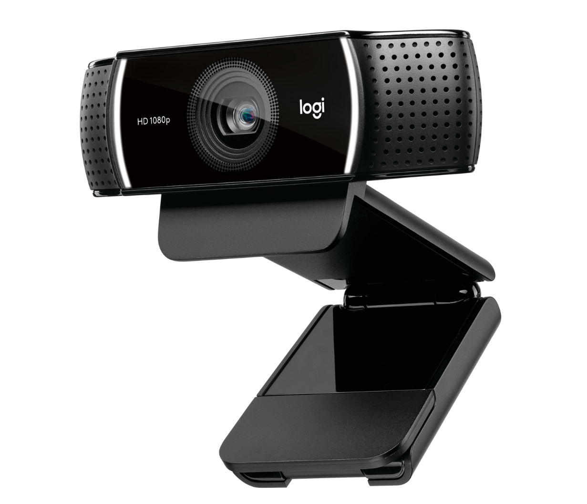
Input - Camera

Slide 46
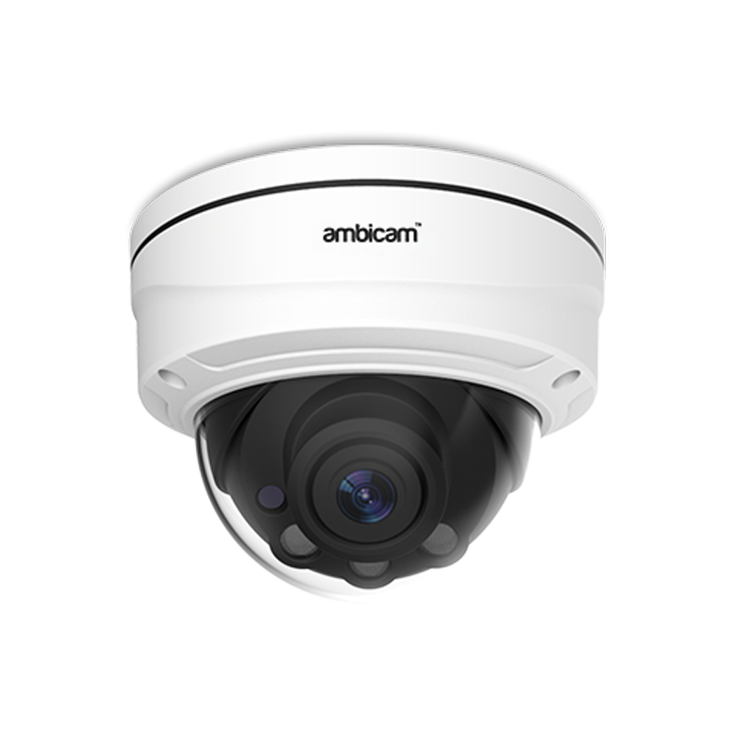
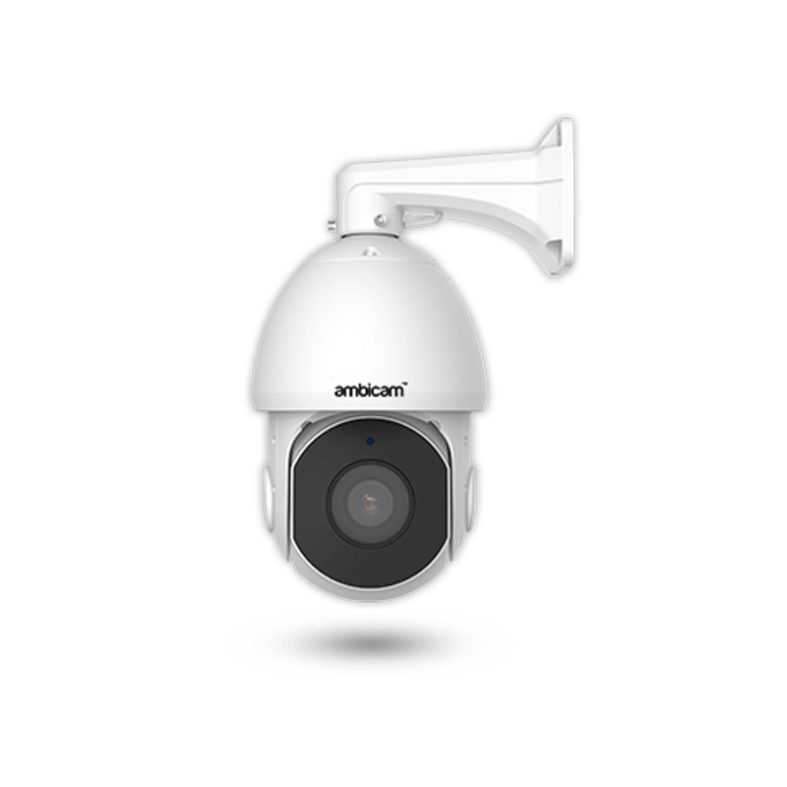
Input - Camera

Slide 47
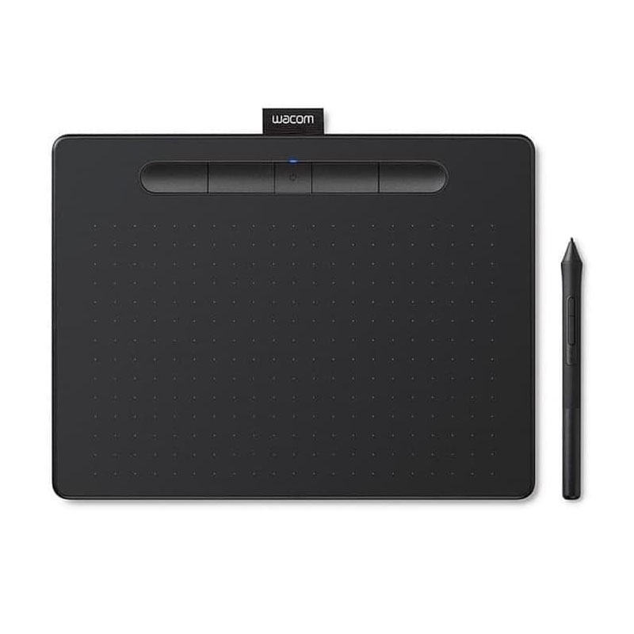
Input – Graphic Tablet

Slide 48
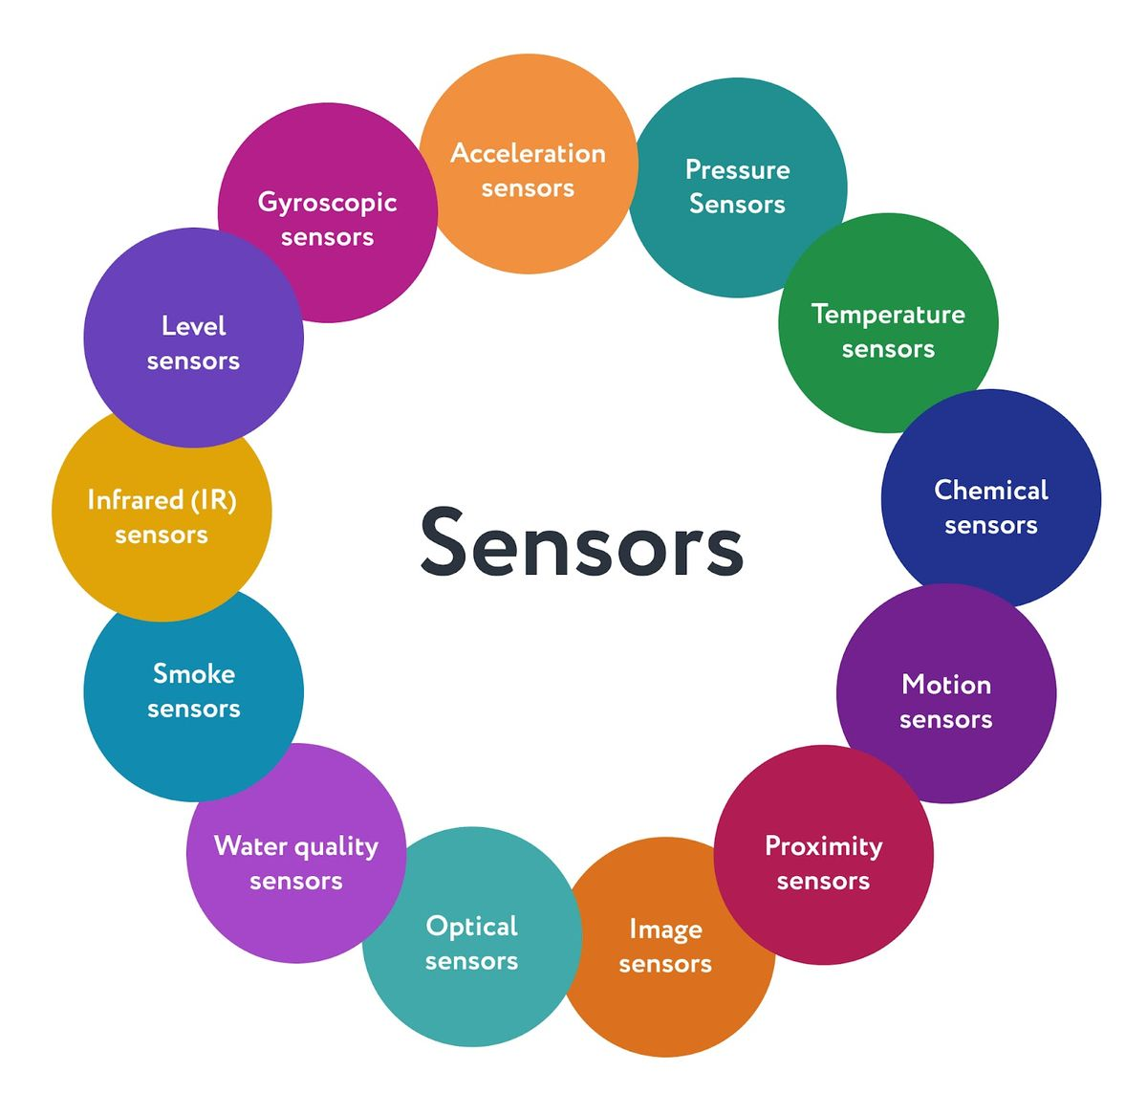
Input - Sensor

Slide 49
Input – Hand Gesture
NEW DRONE TECH: DJI Spark Demo (Palm Control | Hand Gesture Sensor) – YouTube
This is How i Control a RC Drift Car by Gesture Sensing - YouTube

Slide 50
Input – Eye Tracker
Ergoneers: Eye-Tracking Cristiano Ronaldo - YouTube
Tobii Eye Tracking: Windows Interaction Guide – YouTube
Optimizing user experience and advertising research with eye tracking - YouTube

Slide 51
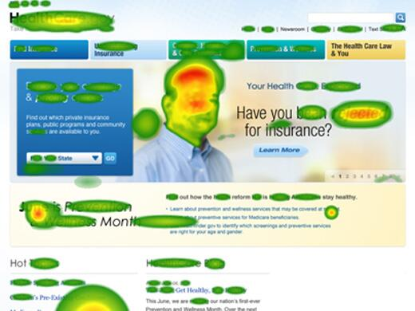
Input – Eye Tracker
Notes:
Heat Map

Slide 52
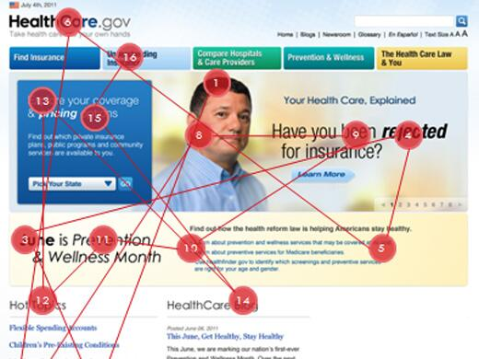
Input – Eye Tracker
Notes:
Saccade Pathways

Slide 53
Input – Brain-Computer Interface
Mysteries of the Brain: Brain-Computer Interface - YouTube

Slide 54
Output

Slide 55
Output
Screen
Projector
LED Display
VR Google/Headset
Speaker
Printer
3D Printer
Vibration
Force Feedback

Slide 56
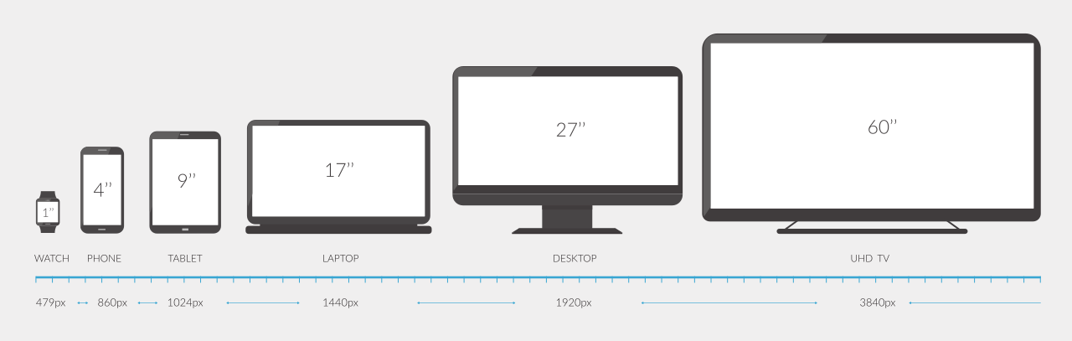
Output – Screen

Slide 57
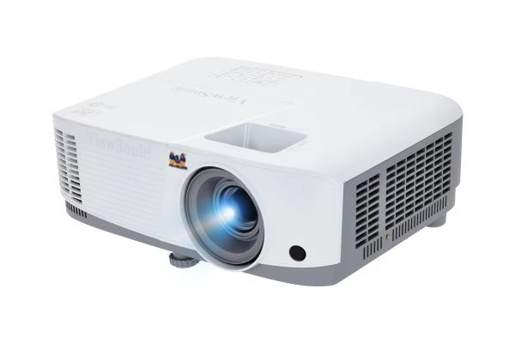
Output - Projector

Slide 58
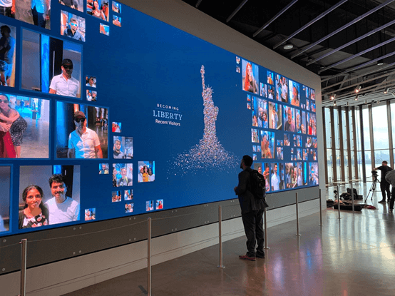
Output – LED Display

Slide 59
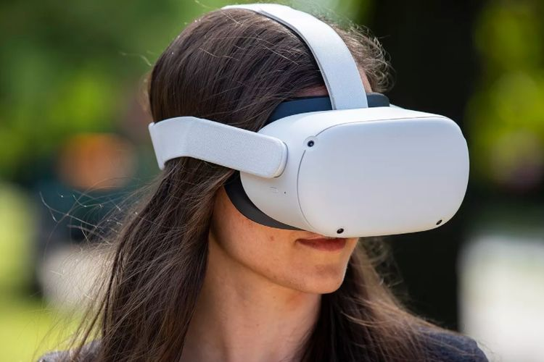
Output – VR Google/Headset

Slide 60
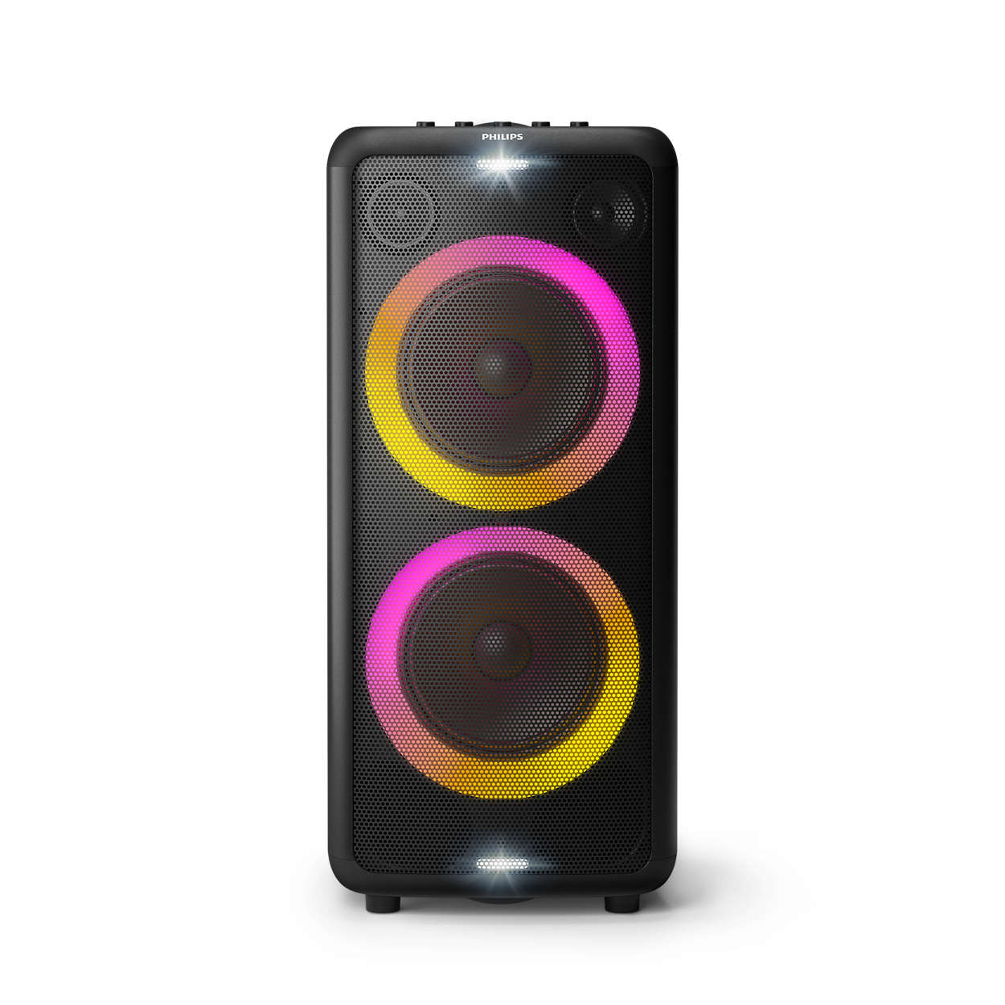
Output – Speaker

Slide 61
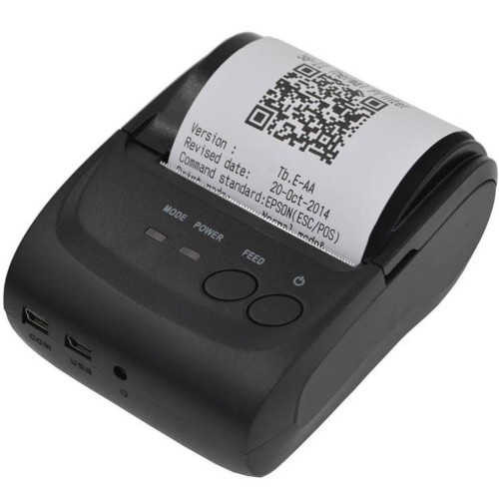
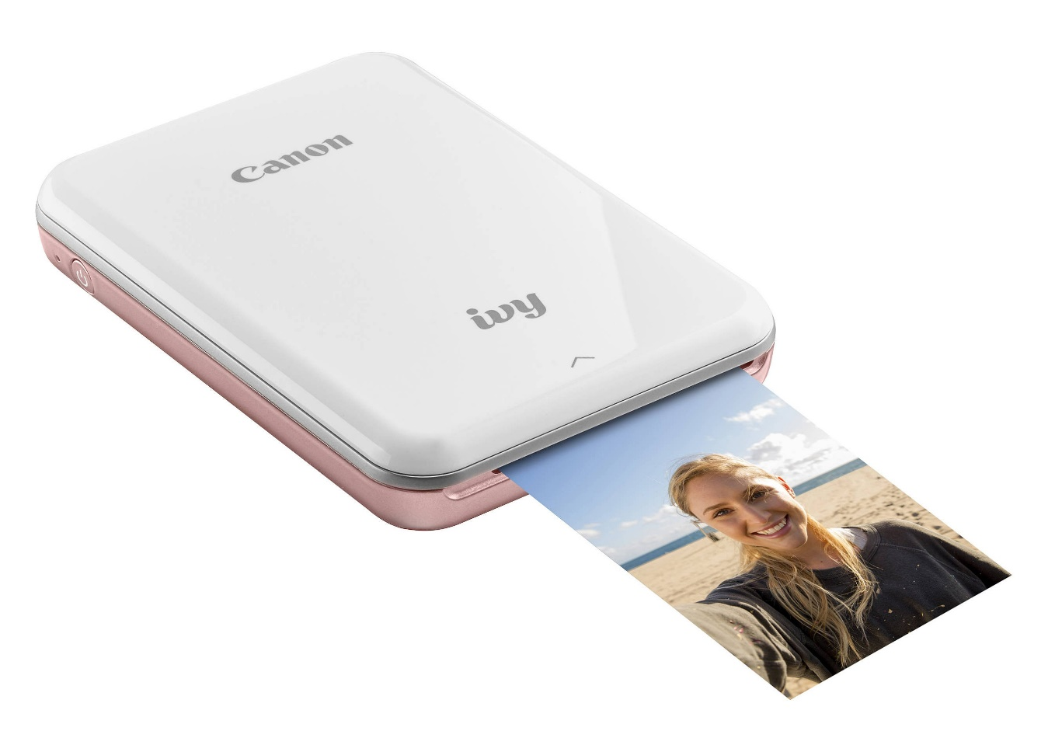
Output - Printer

Slide 62
Output – 3D Printer
Baby Groot - 3D Printing Time Lapse - YouTube

Slide 63
Output - Vibration

Slide 64
Output – Force Feedback
Meta Consumer Force Feedback Haptic VR Gloves Prototype – YouTube
Haptic Technology Demonstration - with Danielle George - YouTube

Slide 65
Computer Capability

Slide 66
Capabilities
Distributed Computing
Virtualization
Cloud Computing
Virtual Reality
Augmented Reality
Artificial Intelligence
IoT

Slide 67
Distributed Computing
USER INTERFACE
BUSINESS LOGIC
DATABASE

Slide 68
Distributed Computing
USER INTERFACE
BUSINESS LOGIC
DATABASE

Slide 69
Distributed Computing
Business Processes
Service
Service
Service
Business Rules
Business Rules
Business Rules
Server/Host
Server/Host
Server/Host

Slide 70

Distributed Computing

Slide 71
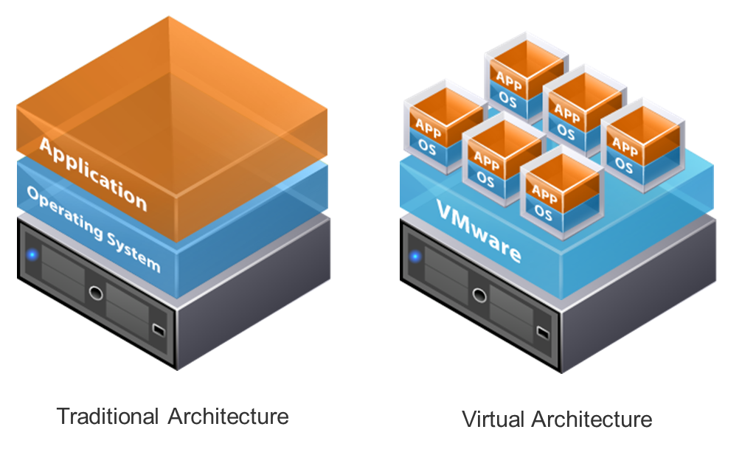
Virtualization

Slide 72
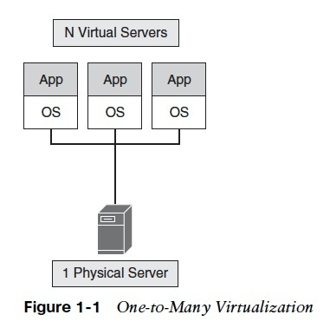
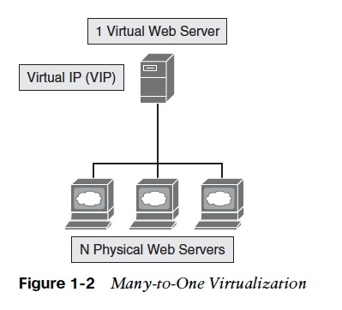
Virtualization

Slide 73
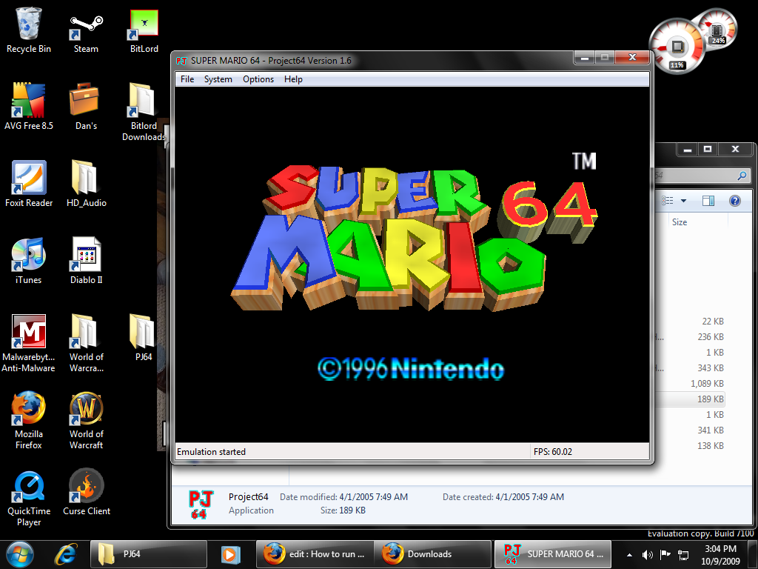
Virtualization

Slide 74
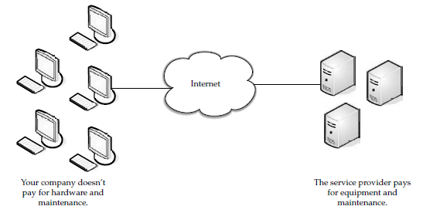
Cloud Computing

Slide 75
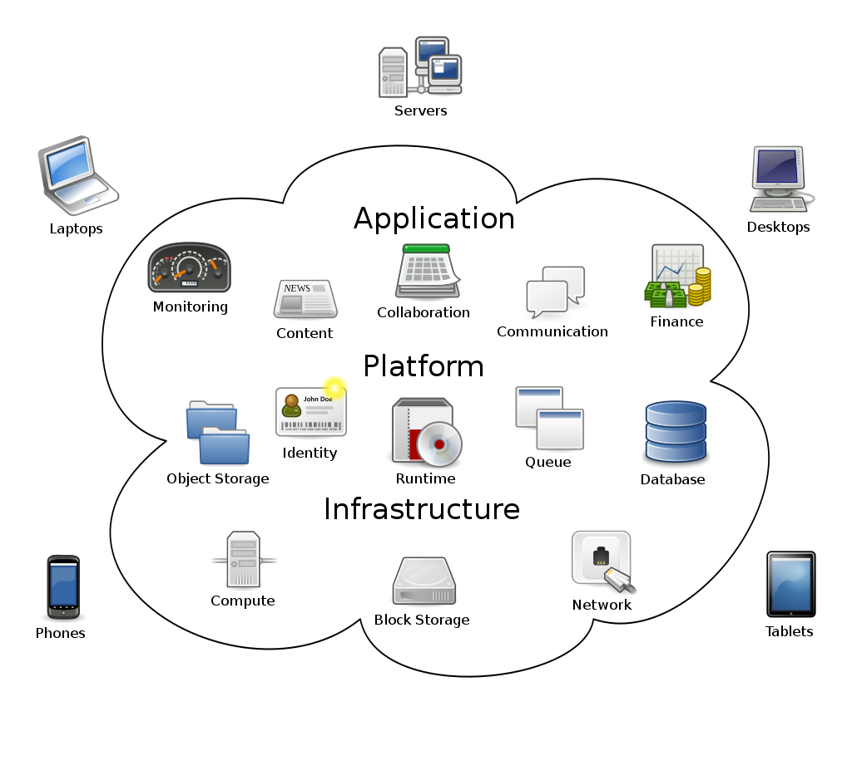
Cloud Computing

Slide 76

Virtual Reality

Slide 77
Virtual Reality

Slide 78

Augmented Reality

Slide 79

Augmented Reality

Slide 80

Augmented Reality

Slide 81

Artificial Intelligence

Slide 82

Artificial Intelligence

Slide 83
Artificial Intelligence
Multi-Agent Hide and Seek - YouTube

Slide 84

IoT

Slide 85
IoT
Life Simplified with Connected Devices - YouTube

